Slide 1

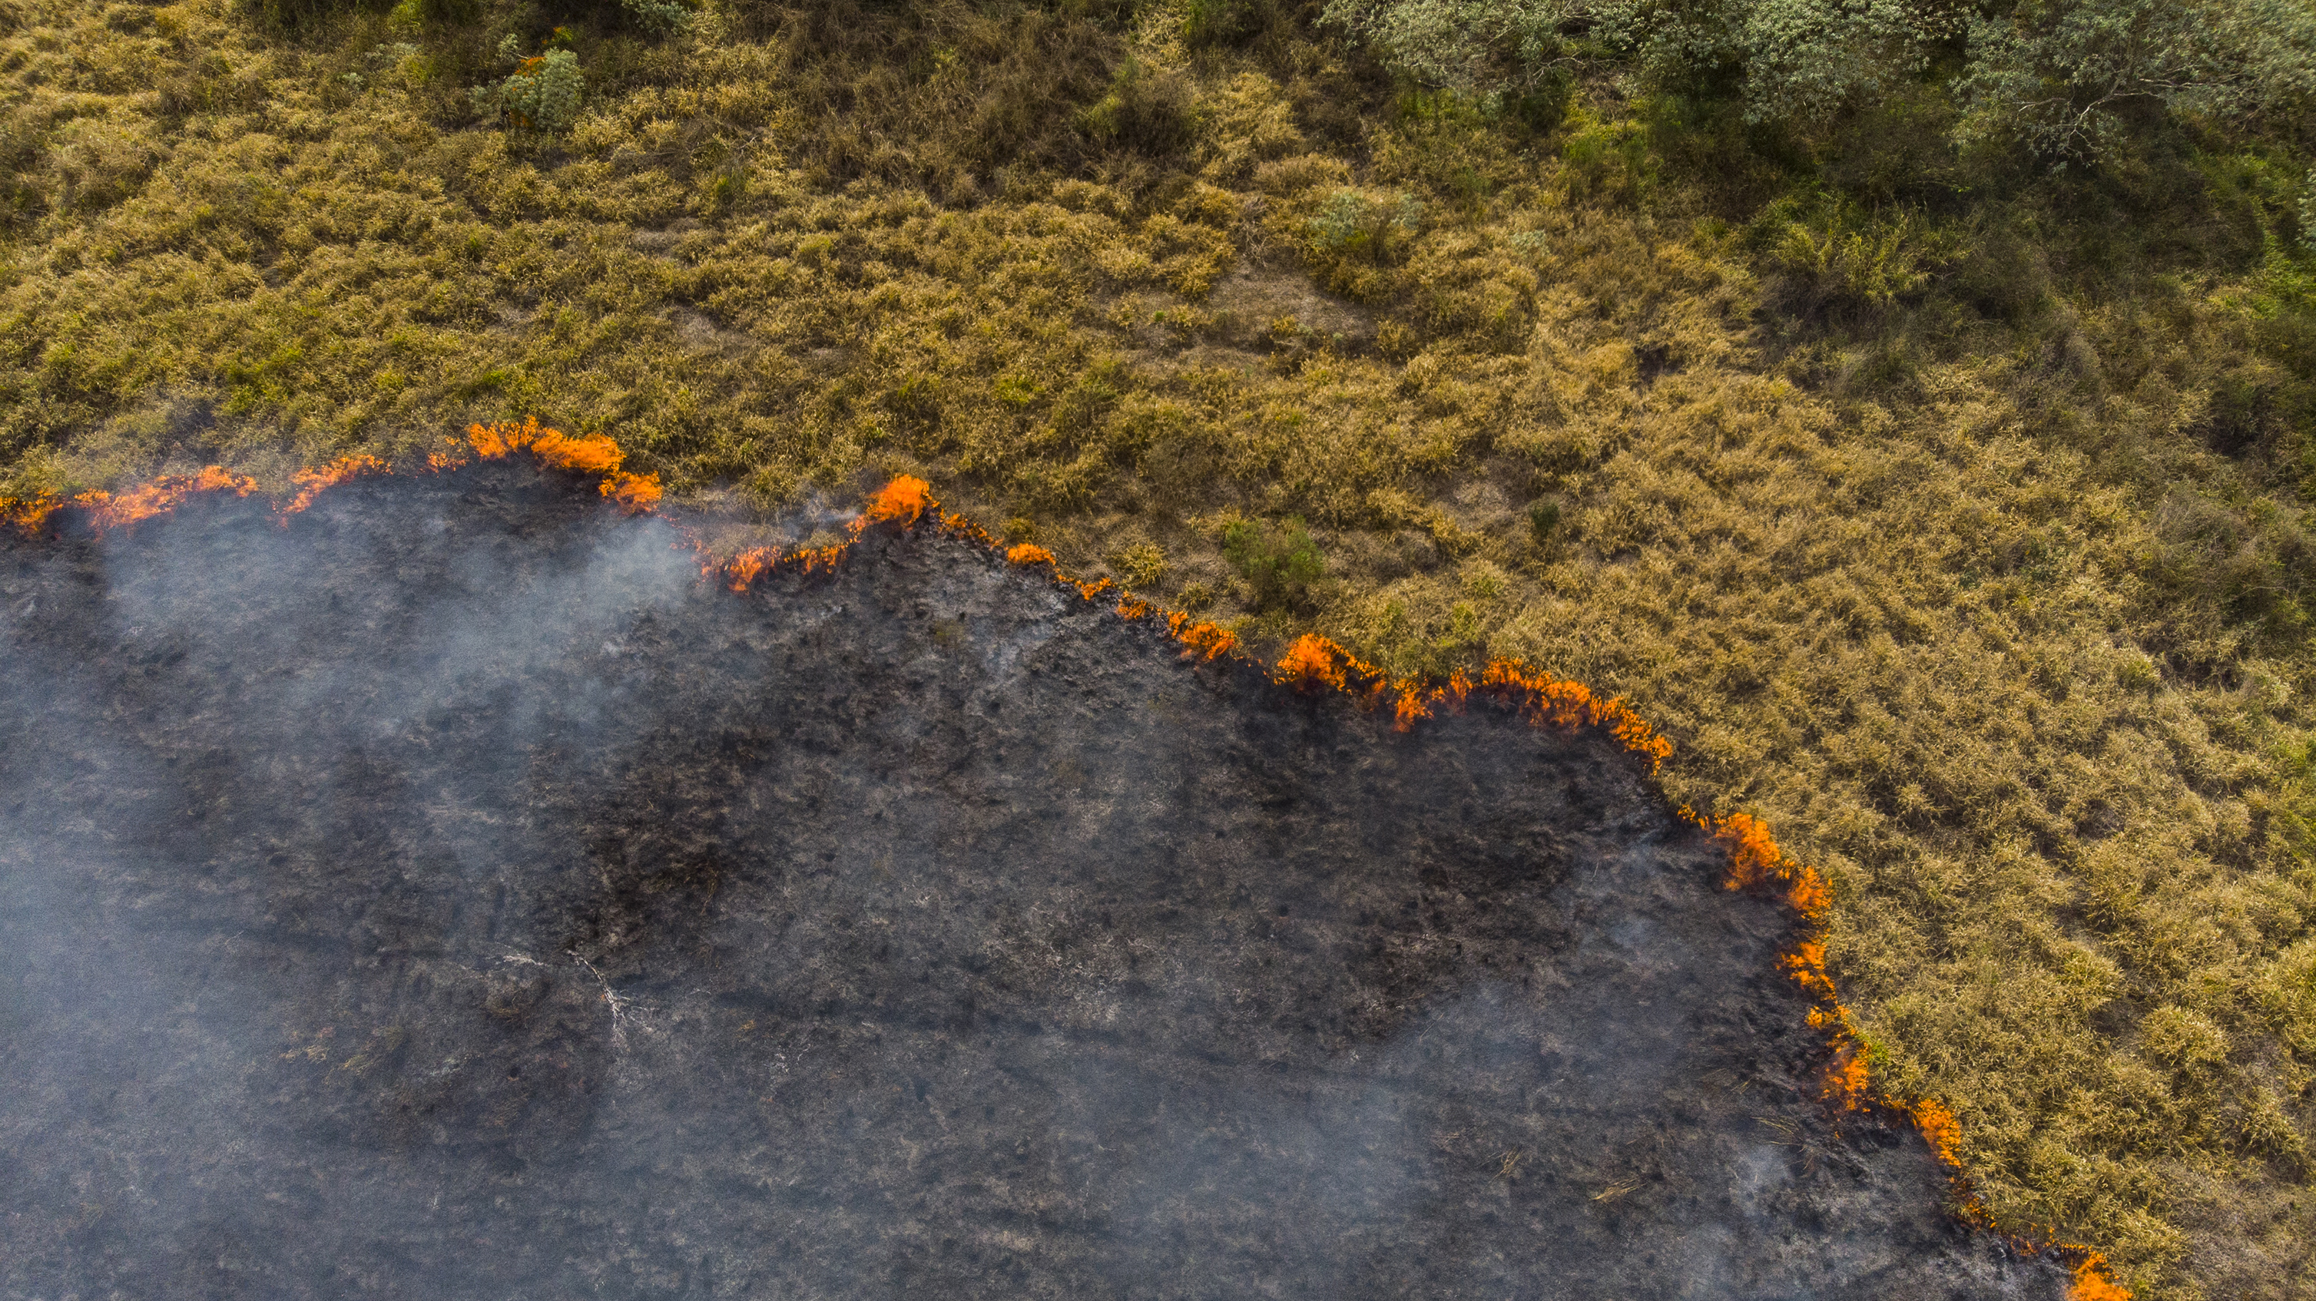
Wildfire Assessment and Predictive Modelling
ENGG 680 – Introduction to Digital Engineering
Presented By:- Group 5 Project
Presented to: Prof. Hongzhou Yang
Date: 02 December 2024

Slide 2
Team Members
1 | Ashkan Einiaghdam | 30270232
2 | Boya Douho | 30261119
3 | Chunsheng Xiao | 30066914
4 | Kazi Zarin Tasnim Rafa | 30233941
5 | Ray Pan | 30265201
6 | Socretes Saha | 30264159
7 | Vikesh Dharmeshkumar Patel | 30255939

Slide 3
Introduction
Problem
Unpredictive Wildfire in Alberta state
Massive Destruction of wildlife and infrastructure
Existing Solution
Data diversity
Model Adaptivity
Our Approach
Diverse Data Utilization
Regional Customization
Model Integration
Advanced Prediction Capabilities
Scalable Framework

Slide 4
Objectives
Develop a Predictive System
Tailored for Alberta
Utilize Diverse Datasets
Support Prevention Efforts
Notes:
Develop a Predictive System: Create an advanced wildfire risk prediction system using hybrid machine learning models.
Tailored for Alberta: Focus on Alberta, Canada, customizing the model for local environmental and climatic conditions.
Utilize Diverse Datasets: Integrate Sentinel satellite imagery and historical weather data to improve prediction accuracy.
Hybrid Model Integration: Combine CNN, Random Forest, and SVR to leverage their strengths for a robust, adaptive solution.
Support Prevention Efforts: Provide a reliable tool for early wildfire risk assessment to minimize environmental and societal impacts.

Slide 5
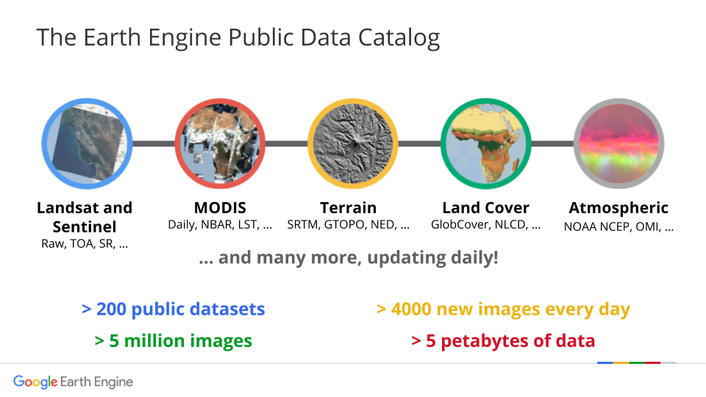
Methodology
Data Acquisition
Data Preprocessing
Model Development
Prediction and
Visualization
Google Earth Engine: Introduction to Google Earth Engine. (n.d.). https://geohackweek.github.io/GoogleEarthEngine/01-introduction/
Google Earth Engine API
GitHub Repository
https://github.com/RayPan-UC/wildfire_prediction.git

Slide 6
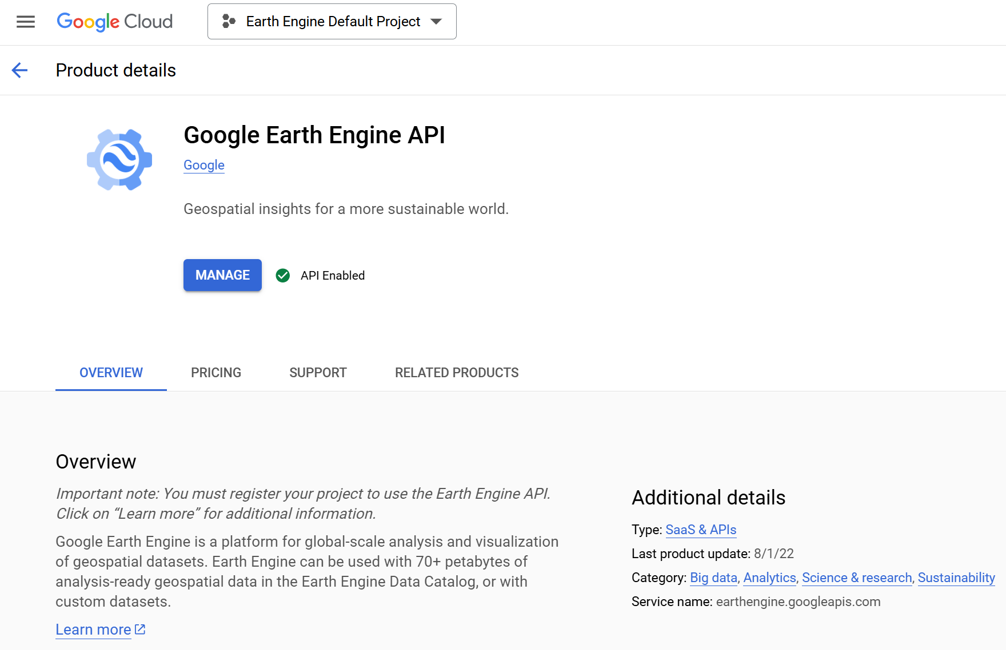
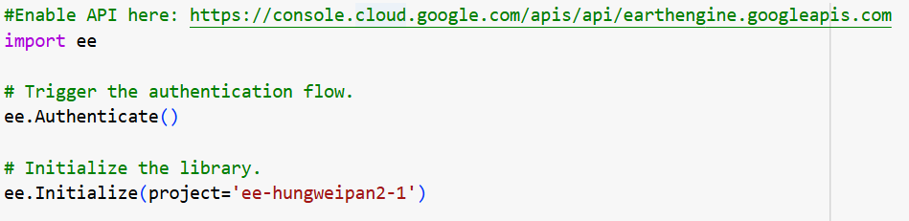
Methodology
Data Acquisition
Data Preprocessing
Model Development
Prediction and
Visualization

Slide 7
Methodology
Data Acquisition
Region of Interest (ROI): Define the area of interest using FAO/GAUL/2015/level1, filtered by administrative boundaries (e.g., Alberta, Canada)
Data Sources:
Fire Data
NDVI Data
Weather Data
Time Frame:
Training Data: 2015–2023 (May–October)
Testing Data: 2024 (May–October)
Data Preprocessing
Model Development
Prediction and
Visualization

Slide 8
Methodology
Data Acquisition
Features | Description | Source | Data Type
NDVI | Vegetation Health Index | MODIS | Continuous
Temperature (°C) | Daily 2m Air Temperature | ECMWF | Continuous
Soil Moisture (%) | Volumetric soil water layer | ECMWF | Continuous
Wind Speed (m/s) | Combined u/v wind components | ECMWF | Continuous
Data Preprocessing
Model Development
Prediction and
Visualization

Slide 9
Methodology
Data Acquisition
Data Preprocessing
Model Development
FireOccured
NDVI
Label
&
Features
Temperature
Soil Moisture
Prediction and
Visualization
Wind Speed

Slide 10
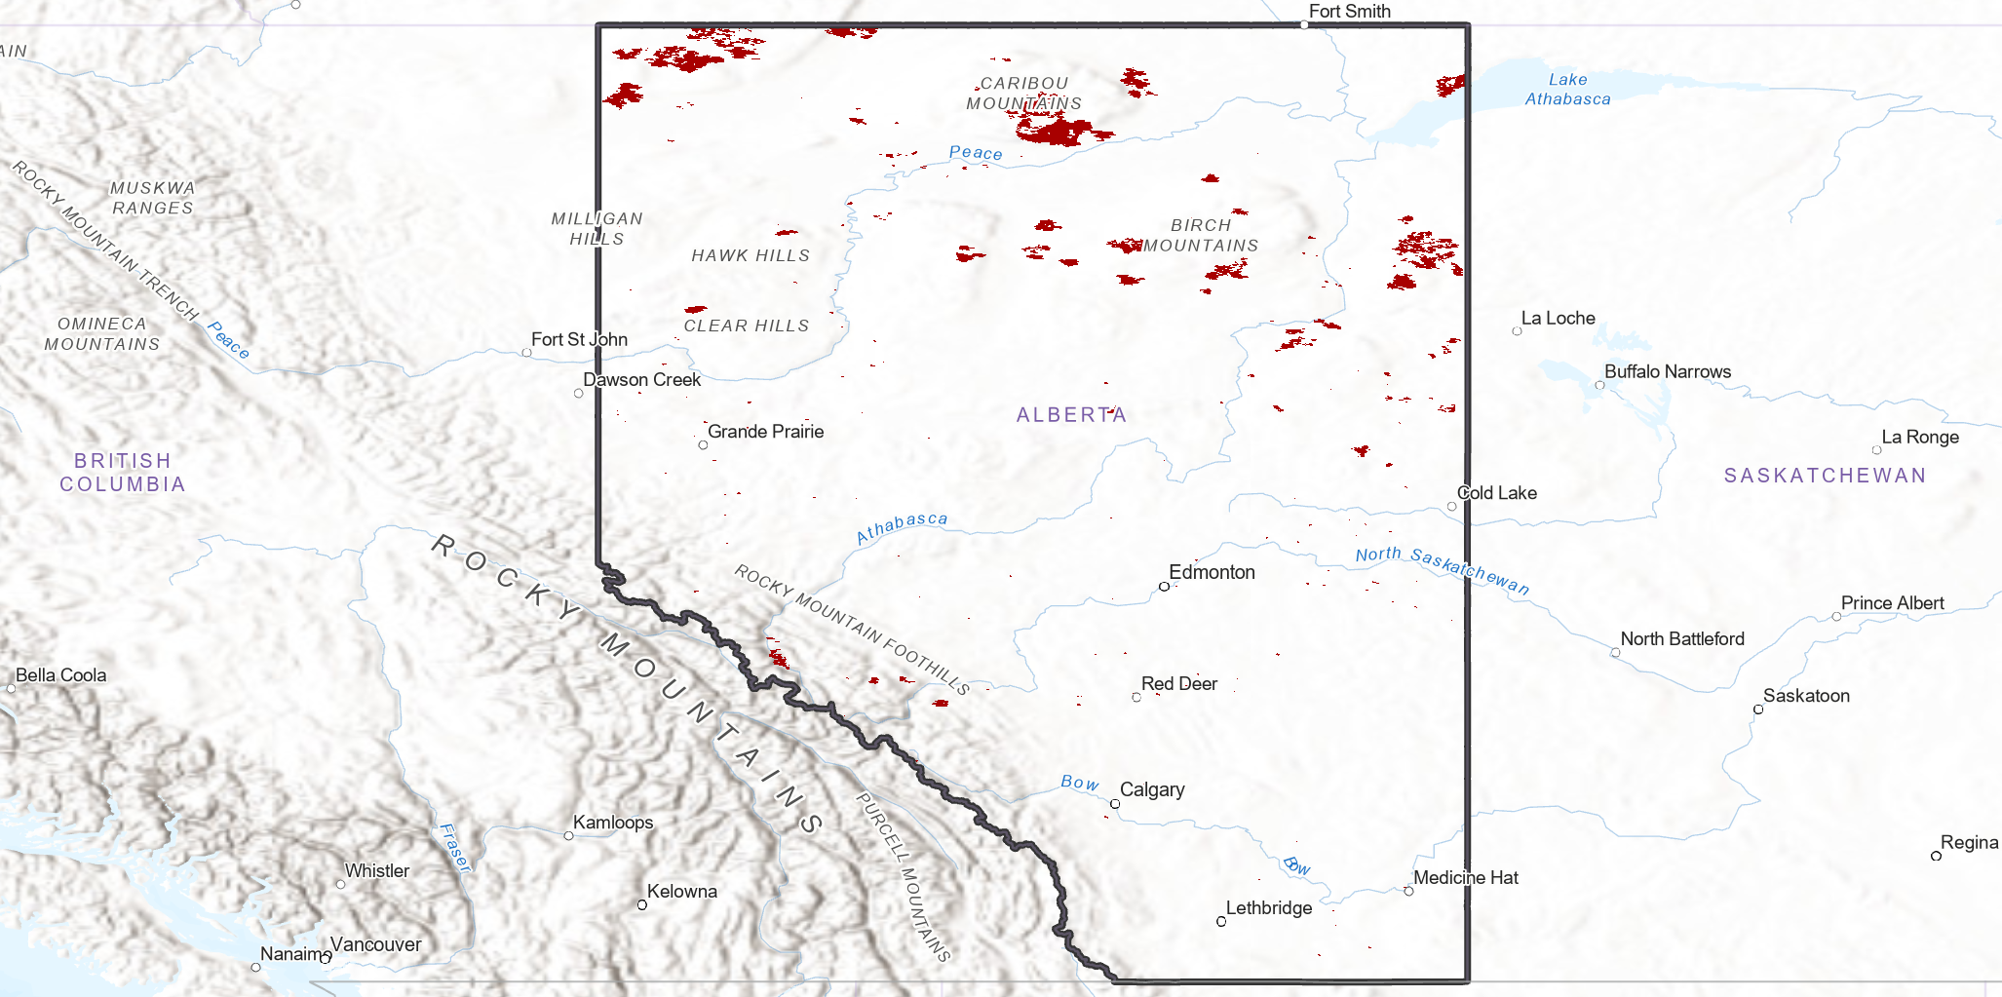
Methodology
Data Acquisition
Data Preprocessing
Model Development
Composite
Export as .csv
Downsample
Prediction and
Visualization

Slide 11
Methodology
Model:
Use a Random Forest classifier for binary wildfire prediction
Features: MaxTemp, MinSoilMoisture, NDVI, max_wind_speed
Label: FireOccurred.
Training:
Train the model on the downsampled training dataset
Save the trained model for reuse (rf_fire_model.joblib)
Data Acquisition
Data Preprocessing
Model Development
Prediction and
Visualization
WHY?
Handles Complex Data
Reduces Overfitting
Improved Accuracy

Slide 12
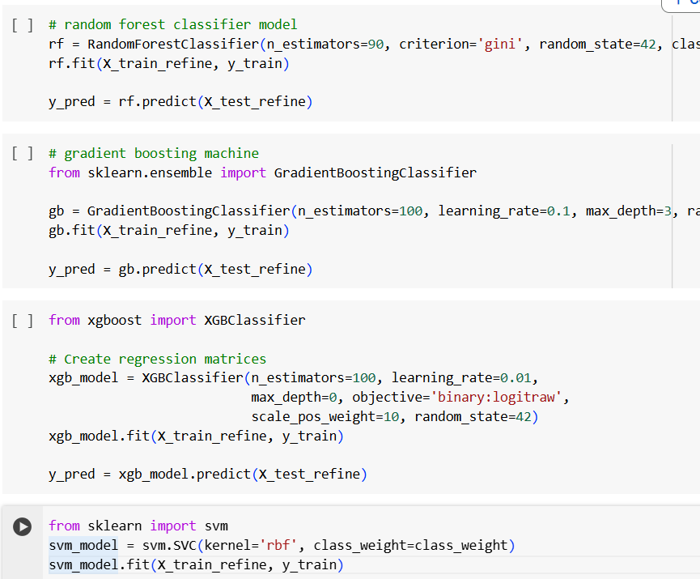
Methodology
Data Acquisition
Data Preprocessing
Model Development
Prediction and
Visualization
Model Training
Random Forest Classifier
Gradient Boosting
XGBoost
SVM
Comment: Random Forest Classifier performs the best.

Slide 13
Methodology
Data Acquisition
Prediction:
Predict fire probabilities on the 2024 testing dataset.
Predict the split 2015-2024 dataset
Append predictions as a new column (FireProbability) to the test data.
Spatial Visualization:
Convert testing data into a GeoTIFF raster file using rasterization techniques.
Output: A 1000-meter resolution GeoTIFF (result.tif) visualizing fire probabilities using ArcGIS Pro.
Data Preprocessing
Model Development
Prediction and
Visualization

Slide 14
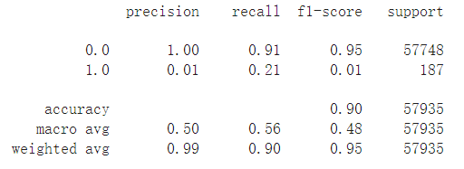
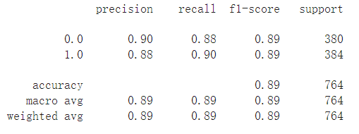
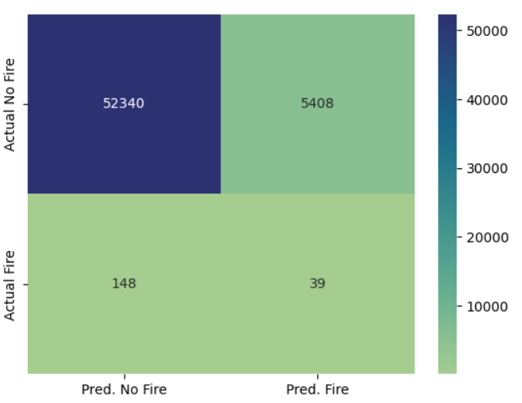
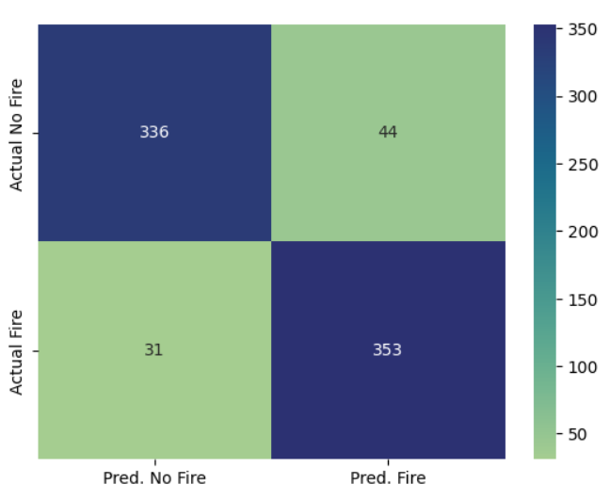
Result (Model Evaluation)
Data Trained :- 2015 – 2023 & Predicted on 2024 Data
Data Trained :- 2015 – 2024 & then Predicted
Notes:
(Comment: Added the steps sequentially. Hopefully, it fits.)

Slide 15
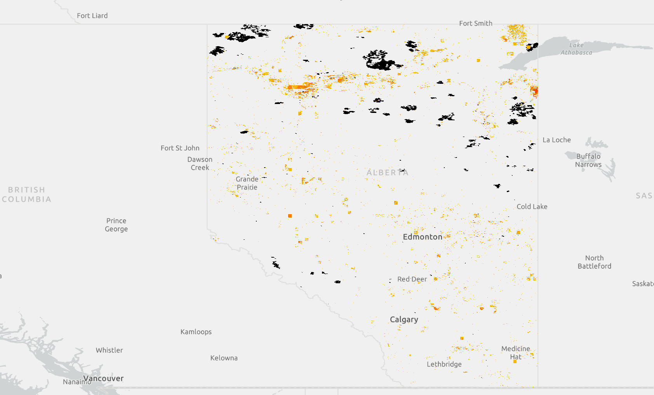
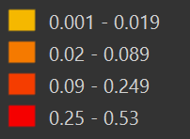
Result (Visualization)
Notes:
(Comment: Added the steps sequentially. Hopefully, it fits.)

Slide 16
Limitations
Class Imbalance: Fewer fire samples affect predictions.
Data Gaps: Missing data and features.
NDVI Accuracy: Sensitive to cloud and snow interference.
Regional Focus: Model tailored to Alberta, limiting generalization.
Static Thresholds: Fixed fire intensity thresholds may oversimplify dynamics.

Slide 17
References
Abid, F., & Izeboudjen, N. (2020). Decision tree-based system on chip for forest fires prediction. 2020 International Conference on Electrical Engineering (ICEE), Istanbul, Turkey, 1-4. https://doi.org/10.1109/ICEE49691.2020.9249954
Collins, L., Griffioen, P., Newell, G., & Mellor, A. (2018). The utility of random forests for wildfire severity mapping. Remote Sensing of Environment, 216, 374–384. https://doi.org/10.1016/j.rse.2018.07.005
Guo, Y., Chen, G., Wang, Y., Zha, X., & Xu, Z. (2022). Wildfire identification based on an improved two-channel convolutional neural network. Forests, 13(8), 1302. https://doi.org/10.3390/f13081302
Nikova, H., & Deliyski, R. (2023). Binary regression model for automated wildfire early prediction and prevention. 2023 International Scientific Conference on Computer Science (COMSCI), Sozopol, Bulgaria, 1-5. https://doi.org/10.1109/COMSCI59259.2023.10315856
Singh, K. R., Neethu, K., Madhurekaa, K., Harita, A., & Mohan, P. (2021). Parallel SVM model for forest fire prediction. Soft Computing Letters, 3, 100014. https://doi.org/10.1016/j.socl.2021.100014
Sayad, Y. O., Mousannif, H., & Al Moatassime, H. (2019). Predictive modeling of wildfires: A new dataset and machine learning approach. Fire Safety Journal, 104, 130–146. https://doi.org/10.1016/j.firesaf.2019.01.006
Pérez-Sánchez, N., Jimeno-Sáez, N., Senent-Aparicio, N., Díaz-Palmero, N., & De Dios Cabezas-Cerezo, N. (2019). Evolution of burned area in forest fires under climate change conditions in Southern Spain using ANN. Applied Sciences, 9(19), 4155. https://doi.org/10.3390/app9194155
Google Earth Engine API. (n.d.). Landsat Surface Reflectance and Meteorological Data for Alberta.

Slide 18


Slide 19


Slide 20




Future Direction
If we had more time, how could we add to the project?
Extend AOI
Detailed Time
Include more Features
Notes:
Extend our AOI
Detailed timeline to see how wildfire spread
More change items than just burned area

Slide 21
FUTURE SCOPE
Model Scalability
Integration with real-time systems
Multi-Hazard Prediction
Decision- Making Support
Incorporation of Advanced data sources
Community Applications

